Slide 1
Predicate Logic
Discrete Mathematics

Slide 2
Predicate
A predicate is a proposition function
Takes as input one or more objects
Returns a proposition
A predicate does not have a truth value
P(x)= x > 3
“ x is greater than 3”.

Slide 3
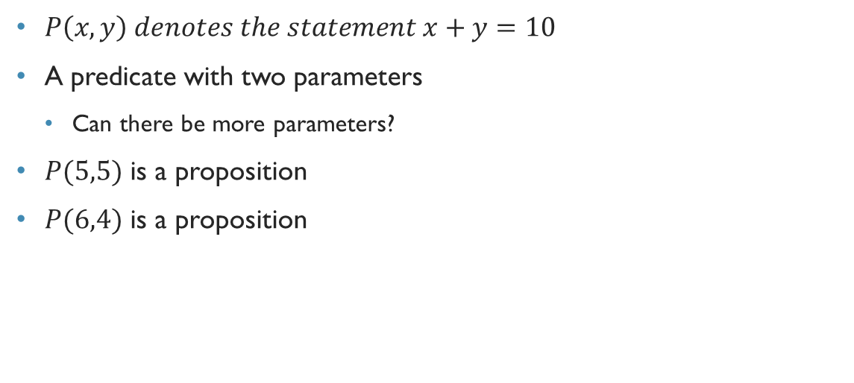
Another example
$P\left(x,y\right) denotes the statement x+y=10$
A predicate with two parameters
Can there be more parameters?
$P(5,5)$ is a proposition
$P(6,4)$ is a proposition

Slide 4
Example
1.Let P(x) denote the statement "x > 3." What are the truth values of P(4) and P(2)?
2. Let Q(x, y) denote the statement "x = y + 3." What are the truth values of the propositions Q( I, 2) and Q(3, O)?
3. Let R(x, y, z) denote the statement "x + y = z.” What are the truth values of the propositions R(I, 2, 3) and R(O, 0, I)?

Slide 5
Advantages of predicates
More general than simple propositions
We can quantify objects

Slide 6
… wait, quantify??

Slide 7
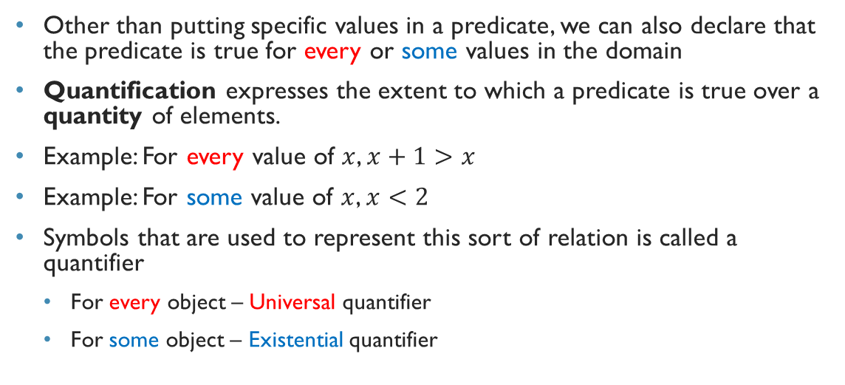
Quantify
Other than putting specific values in a predicate, we can also declare that the predicate is true for every or some values in the domain
Quantification expresses the extent to which a predicate is true over a quantity of elements.
Example: For every value of $x$, $x+1>x$
Example: For some value of $x$, $x<2$
Symbols that are used to represent this sort of relation is called a quantifier
For every object – Universal quantifier
For some object – Existential quantifier

Slide 8

Universal quantifier
Let $P\left(x\right) denote the statement x+1>x$
For every value of $x$, $x+1>x$
We can write $∀x P(x)$
$∀$ is called the universal quantifier

Slide 9

Existential quantifier
Let $Q\left(x\right) denote the statement x<2$
For some value of $x$, $x<2$
We can write $∃x Q(x)$
$∃$ is called the existential quantifier

Slide 10

Exercise
Let P(x) be the statement "x + I > x." What is the truth value of the quantification $∀x P\left(x\right)$where the domain consists of all real numbers?

Slide 11

Exercise
Let Q(x) be the statement "x < 2." What is the truth value of the quantification $∀x$Q(x), where the domain consists of all real numbers?

Slide 12
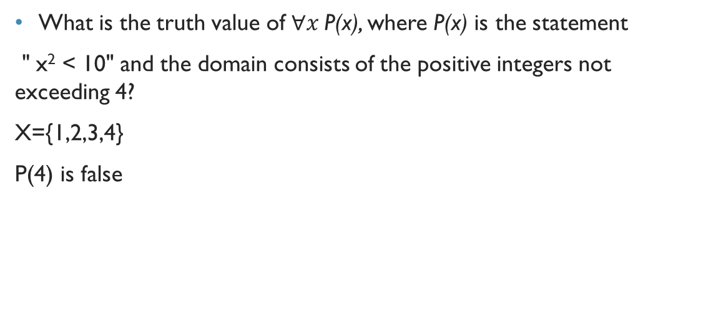
Exercise
What is the truth value of $∀x$P(x), where P(x) is the statement
" x² < 10" and the domain consists of the positive integers not exceeding 4?
X={1,2,3,4}
P(4) is false

Slide 13

Exercise
Let P(x) denote the statement "x > 3." What is the truth value of the quantification $∃x$P(x), where the domain consists of all real numbers?

Slide 14

Exercise
What is the truth value of $∃$x P(x), where P(x) is the statement
" x² > I 0" and the domain consists of the positive integers not exceeding 4?

Slide 15
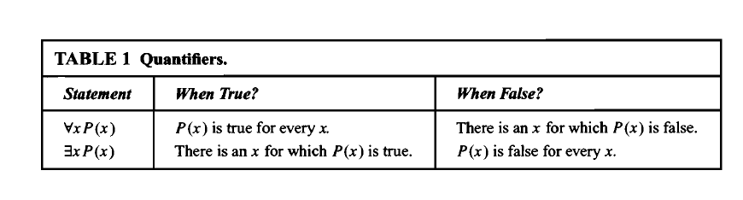
Table 1

